Slide 1
Brain Tumor Detection using Deep Learning
Guide, Team Members,
Dr. A. SARAVANAN KOTA RAMA SAI VAMSI
HARIRAM S
Gokul PANDIAN M
Notes:
Brain tumors are a serious medical condition that require early detection for successful treatment. In this presentation, we will explore how deep learning can be used to improve the accuracy and efficiency of brain tumor detection, and discuss the different techniques and challenges involved in this process.

Slide 2
INTRODUCTION
Brain tumor detection is a critical task in the medical field, and deep learning has emerged as a powerful tool for detecting brain tumors.
Two common approaches for brain tumor detection using deep learning are pattern detection and anomaly detection.
These techniques involve training models to identify patterns or abnormalities in medical images such as MRI or CT scans.
By enabling early detection and timely treatment of brain tumors, deep learning has the potential to save countless lives and improve patient outcomes.
‎
Notes:
Medical imaging is a critical tool for brain tumor detection. Different types of imaging techniques have different strengths and weaknesses, and it's important to understand how to use them effectively to improve the accuracy of brain tumor detection.

Slide 3
Why pattern and anamoly detection?
Identifying trends and patterns: By analyzing data, we can discover patterns that can help us make informed decisions. Pattern detection can help in forecasting future trends, predicting customer behavior, and detecting opportunities for improvement.
Preventing fraud and security breaches: Anomaly detection can help in identifying unusual behavior in a system, such as fraudulent transactions or cybersecurity attacks. Early detection of such anomalies can help in preventing significant damages and losses.
Improving operational efficiency: By monitoring industrial processes, it is possible to identify patterns that can help optimize performance, reduce downtime, and improve quality control.
Enhancing customer experience: By analyzing customer behavior, businesses can identify patterns and anomalies that can help in delivering personalized experiences and improving customer satisfaction.
Overall, pattern and anomaly detection are crucial tools in today's data-driven world, enabling organizations to make data-driven decisions, prevent losses, and enhance operational efficiency.

Slide 4
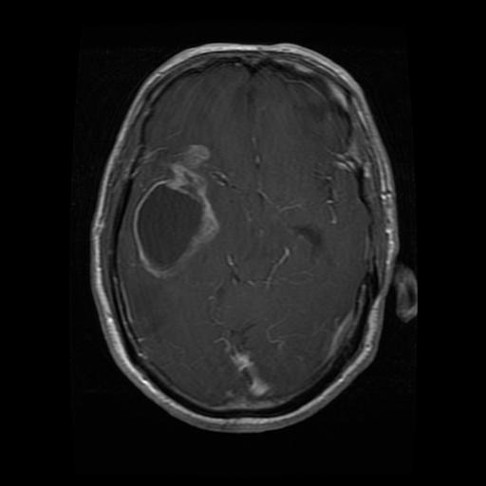
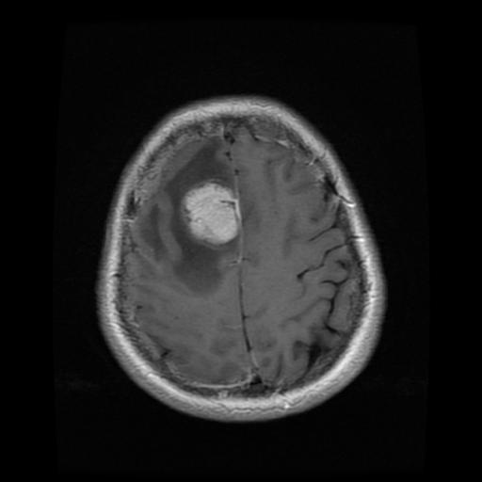
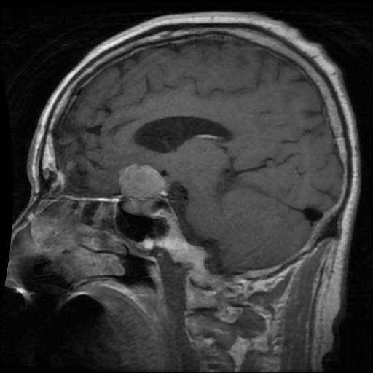
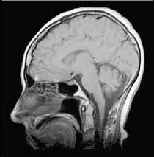
DATASET
In our dataset, we have 4 types and which are
Training Images
Glioma – 1321 Images
Meningioma – 1339 Images
Pituitary – 1457 Images
No Tumor – 1595 Images
Testing Images - 1311
Total Number of 7023 Images in the Dataset

Slide 5
Data Preprocessing
Importance of Data Preprocessing for Deep Learning
Image Normalization: Adjusting the brightness and contrast of images to improve consistency and reduce noise
Feature Extraction: Identifying and extracting relevant features from medical images to improve the accuracy of deep learning models
‎
Notes:
Data preprocessing is a critical step in preparing medical images for deep learning analysis. By normalizing images and extracting relevant features, the accuracy of deep learning models can be significantly improved.

Slide 6
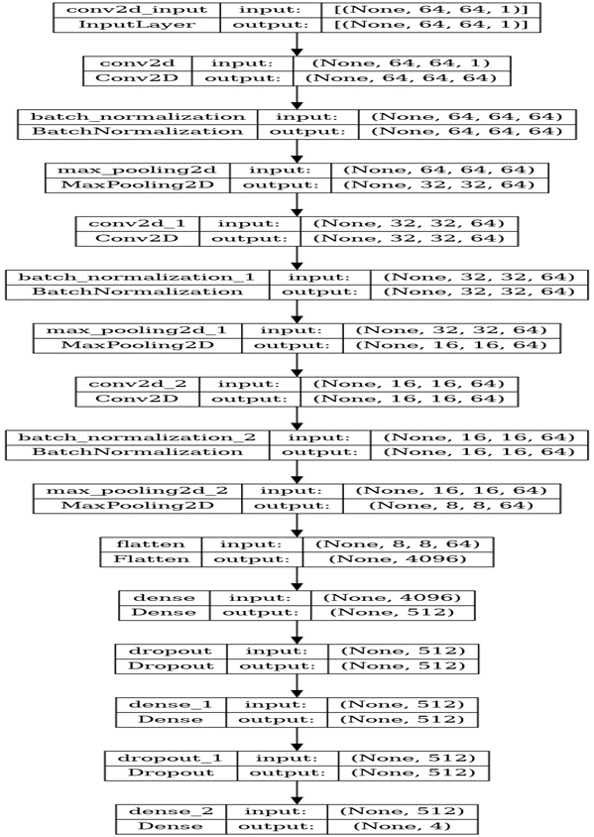
Neural Network Architecture
Types of Neural Network Architectures for BTD
Convolutional Neural Networks (CNNs): A type of neural network that is particularly effective for image analysis
‎
Notes:
Different types of neural network architectures can be used for brain tumor detection, depending on the specific requirements of the project. Convolutional neural networks are particularly effective for image analysis, while recurrent neural networks are particularly effective for sequential data analysis.

Slide 7
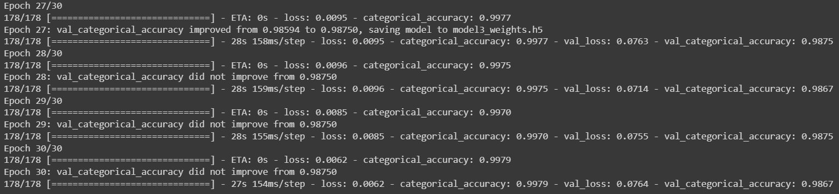
Training and Validation
Process of Training and Validating a DL Model
Hyperparameter Tuning: Adjusting the parameters of a deep learning model to improve its accuracy
Cross-Validation: Evaluating the performance of a deep learning model on multiple subsets of the data to reduce overfitting
Notes:
Training and validating a deep learning model for brain tumor detection requires careful planning and execution. By adjusting the hyperparameters of the model and using cross-validation to reduce overfitting, the accuracy of the model can be significantly improved.

Slide 8
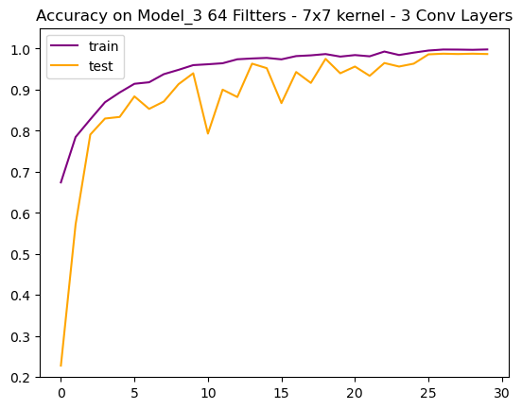
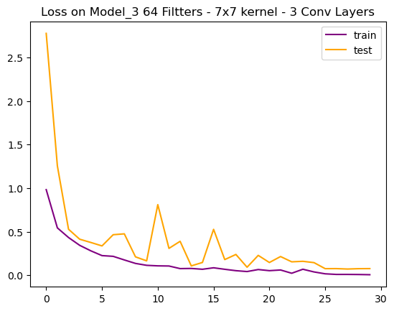
Performance Metrics
Performance Measure for DL Model
Notes:
Different performance metrics can be used to evaluate the accuracy of a deep learning model for brain tumor detection. By using metrics such as sensitivity, specificity, and F1 score, the performance of the model can be accurately assessed.

Slide 9

RESULTS
‎
Notes:
Interpretability is a critical aspect of deep learning for brain tumor detection. By using techniques for visualizing the features learned by a model and explaining the decisions made by a model, the accuracy and reliability of the model can be improved.

Slide 10
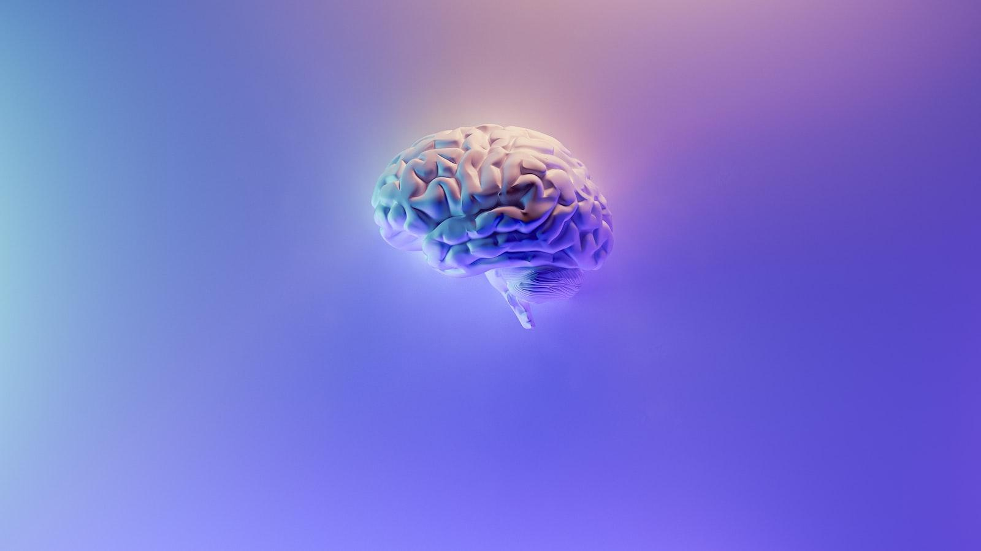
Challenges and Limitations
Challenges and Limitations of Deep Learning for Brain Tumor Detection
Data Scarcity: Limited availability of high-quality medical imaging data for deep learning analysis
Model Interpretability: Difficulty in interpreting the decisions made by deep learning models
‎
Notes:
Deep learning for brain tumor detection is not without its challenges and limitations. Data scarcity and model interpretability are two of the most significant challenges facing the field, and it's important to understand how to address these challenges to improve the accuracy and reliability of deep learning models.

Slide 11

Future Directions
Future Directions of Deep Learning for Brain Tumor Detection
Generative Adversarial Networks (GANs): Using GANs to generate synthetic medical images for deep learning analysis
Federated Learning: Using federated learning to train deep learning models across multiple institutions without sharing patient data
‎
Notes:
The future of deep learning for brain tumor detection is bright, with many exciting developments on the horizon. Generative adversarial networks and federated learning are just two of the many promising directions for future research in this field.

Slide 12
Conclusion
Key Insights and Recommendations for Deep Learning in Brain Tumor Detection
Deep learning is a powerful tool for improving the accuracy and efficiency of brain tumor detection
Proper data preprocessing, neural network architecture, and training and validation are critical for successful deep learning analysis
Interpretability and transfer learning are important considerations for improving the accuracy and reliability of deep learning models
Notes:
In conclusion, deep learning is a powerful tool for improving the accuracy and efficiency of brain tumor detection. By following best practices for data preprocessing, neural network architecture, and training and validation, the accuracy of deep learning models can be significantly improved. Additionally, interpretability and transfer learning are important considerations for improving the accuracy and reliability of deep learning models.

Slide 13
THANK YOU

